Slide 1
Three-dimensional Viewing

Slide 2
Literature
Shirley et al.: chapter 7

Slide 3
Pipeline
Modeling Coordinate System / Local Coordinate System
modeling transformation
World Coordinate System
viewing transformation
View Coordinate System
projection transformation
Projection Coordinate System
normalization transformation
Normalized Coordinate System / Canonical View Volume
viewport transformation
Device Coordinate System

Slide 4

Pipeline

Slide 5
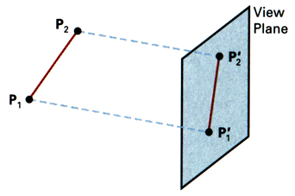
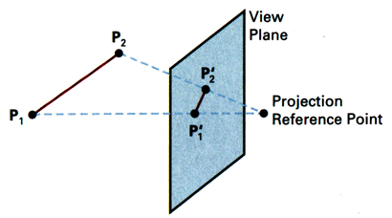
Terms
parallel projection: parallel lines, preserves relative proportions
perspective projection: center of projection, realistic views

Slide 6
2D View
Perspective vs. parallel projection
Viewing plane
Viewing plane
Viewpoint

Slide 7
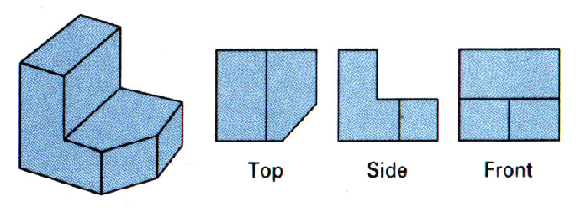
3D Display: Parallel Projection
3 parallel-projection views of an object, showing relative proportions from different viewing positions

Slide 8
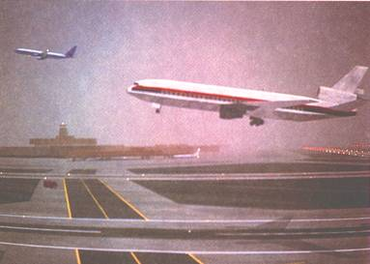
3D Display: Perspective Projection
Demo

Slide 9
How to setup a camera
Terms: (all mean the same)
camera coordinate system
viewing coordinate system
eye coordinate system
Step 1: Define a viewing coordinate system
This becomes the view(ing) transformation in OpenGL
This transform is part of the ModelView matrix in OpenGL
Step 2: Define a projection
This becomes the Projection matrix in OpenGL

Slide 10
Viewing Transformation

Slide 11
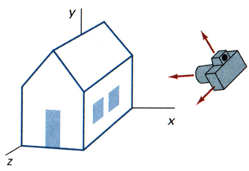
Virtual Camera vs. Photograph
camera position (viewing transformation)
camera orientation (viewing transformation)
aperture of camera (projection transformation)

Slide 12
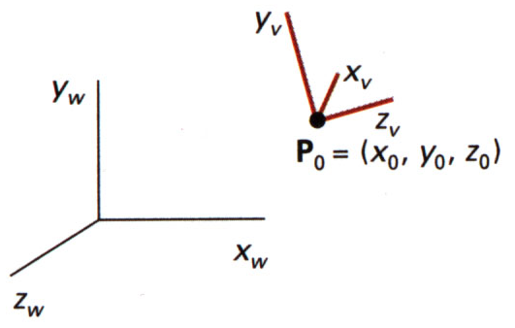
3D Viewing Coordinate System
right handed
axes x_{v}, y_{v}, z_{v}, relative to world-coordinates
y_{v} = view-up vector
(typical) viewing direction = negative z_{v} axis
P₀ =
origin of viewing-coordinate system
camera position
eye position
view point

Slide 13
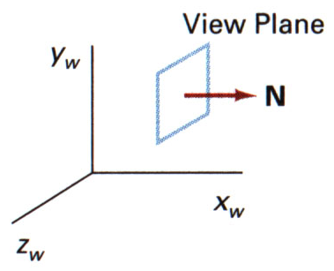
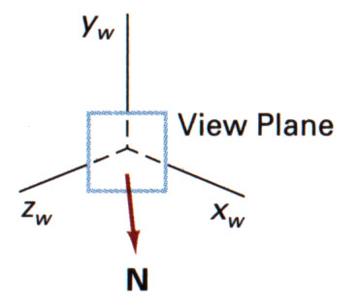
View-plane normal vector N
Term: view-plane normal vector N (= positive z_{v}-axis, points to the viewer)
N=(1,0,1)
N=(1,0,0)

Slide 14
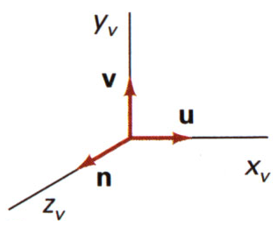
3D Viewing Coordinate System
Alternate variable names
u = x_{v}
v = y_{v}
n = z_{v}

Slide 15
gluLookAt Camera
Input
View point (P₀)
Approximate up-vector (V)
Lookat point (P)
Output: x_{v}, y_{v}, z_{v} ,P₀
or the matrix defining the view transform
I call this camera gluLookAt Camera

Slide 16
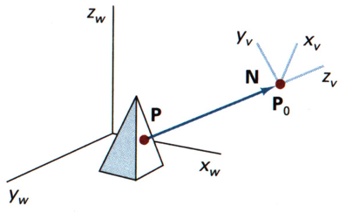
gluLookAt Camera
View-point = viewing-coordinate origin = P₀
positive z_{v}-axis = view-plane normal N

Slide 17
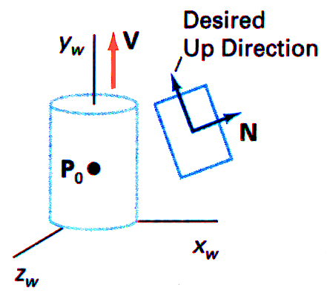
gluLookAt Camera
Problem: Choosing a vector that is orthogonal to N already involves some math
Solution: choose approximate up-vector V and adjust it perpendicular to normal vector N
typically choose V along the y_{w} axis

Slide 18
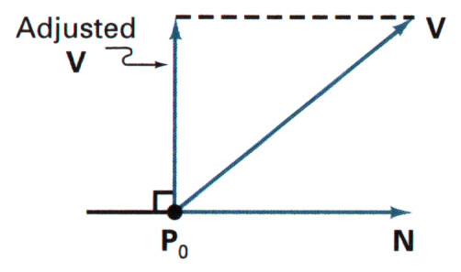
gluLookAt Camera
Computation:

Slide 19
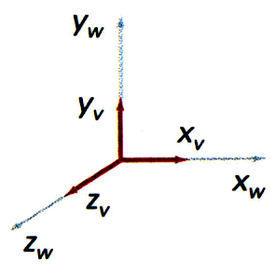
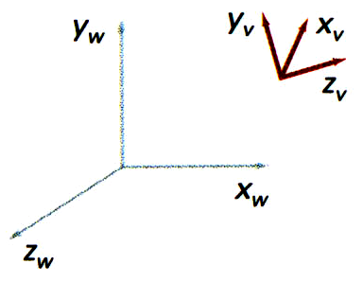
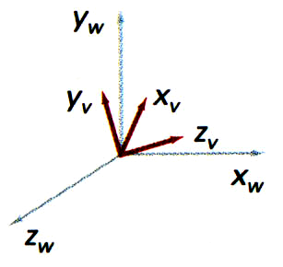
Viewing Transformation Matrix
General Problem: Coordinate System Transformation

Slide 20
gluLookAt Matrix
Final Result
glMultMatrixf(M_ChangeOfBasis);
glTranslated( -eyex, -eyey, -eyez);

Slide 21
Projection Transformation

Slide 22
Projection Transformation
Parallel Projection
Perspective Projection

Slide 23
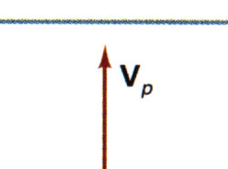
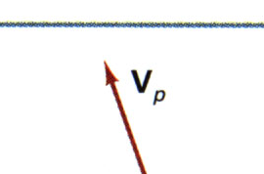
Parallel Projection
orthographic projection
oblique projection
orientation of the projection vector V_{p}

Slide 24
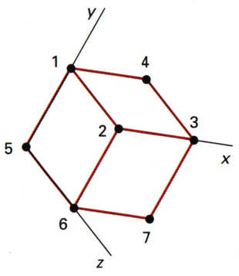
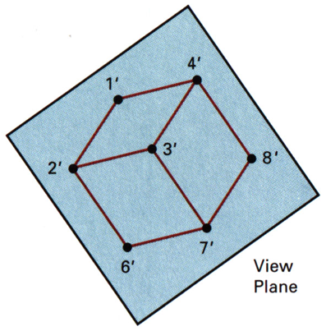
Parallel Projection
plan view
front elevation view
side elevation view
orthographic projections of an object
isometric projection for a cube

Slide 25
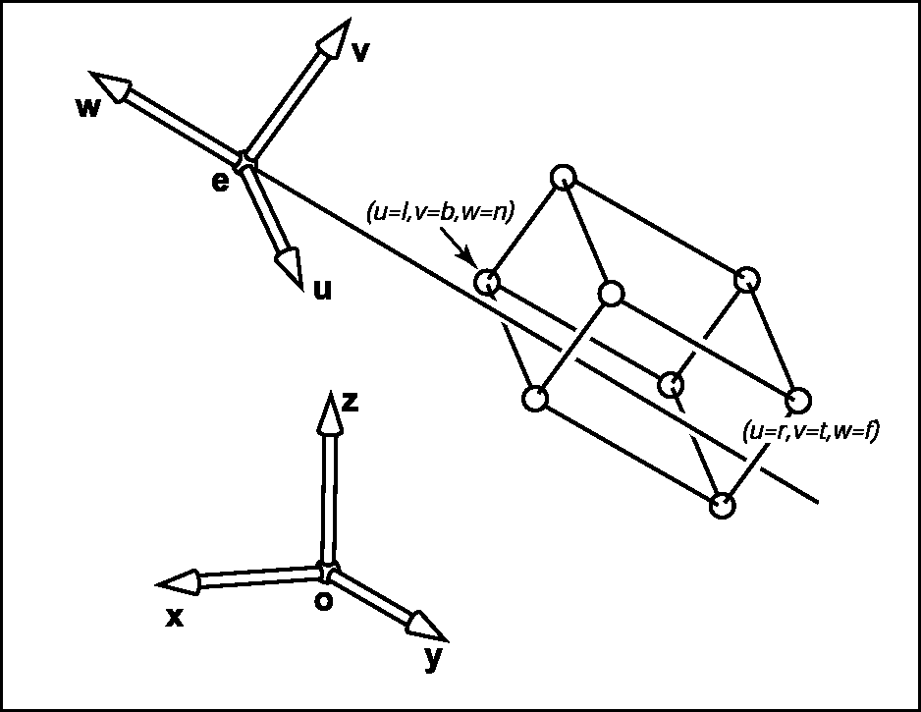
Orthographic Projection
Terms
l – left
r – right
b – bottom
t – top
n – near clipping plane
f – far clipping plane

Slide 26
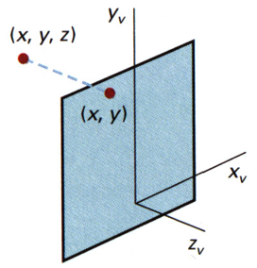
Orthographic Parallel Projection
Look along –z axis
Part1: projection
Part2:
Input: visible cube
Output: coordinates in the canonical view volume

Slide 27
Orthographic Parallel Projection
Solution:
same math as for the viewport transform

Slide 28
Orthographic Parallel Projection
It can be given as a translation followed by a scaling of the form

Slide 29
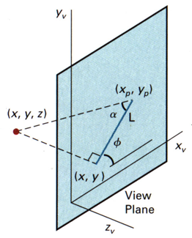
Oblique Parallel Projection with α and φ
Less common

Slide 30
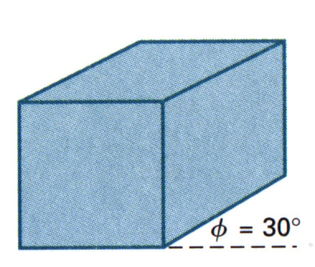
Parallel Proj.: Cavalier Projection
tan α = 1
tan α = 1
depth of the cube is projected equal to the width and the height

Slide 31
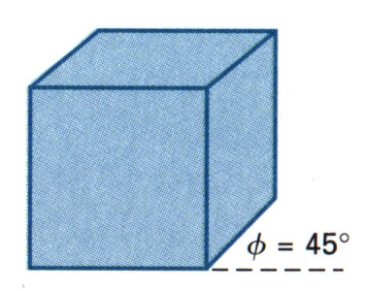
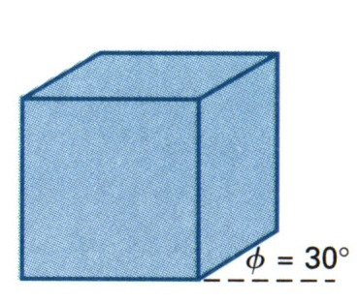
Parallel Proj.: Cabinet Projection
tan α = 2
tan α = 2
depth of the cube is projected as one-half that of the width and height

Slide 32
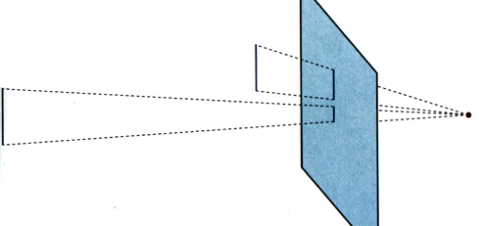
Perspective Projection
projection reference point
view plane
perspective projection of equal-sized objects at different distances from the view plane

Slide 33
Perspective Projection
y
z
x
(Note: similar triangles)

Slide 34
Perspective Projection
Pseudo-dist(z) = A + B/z
It satisfies two conditions:
The pseudo-distance preserves relative distances
It causes lines to map to lines

Slide 35
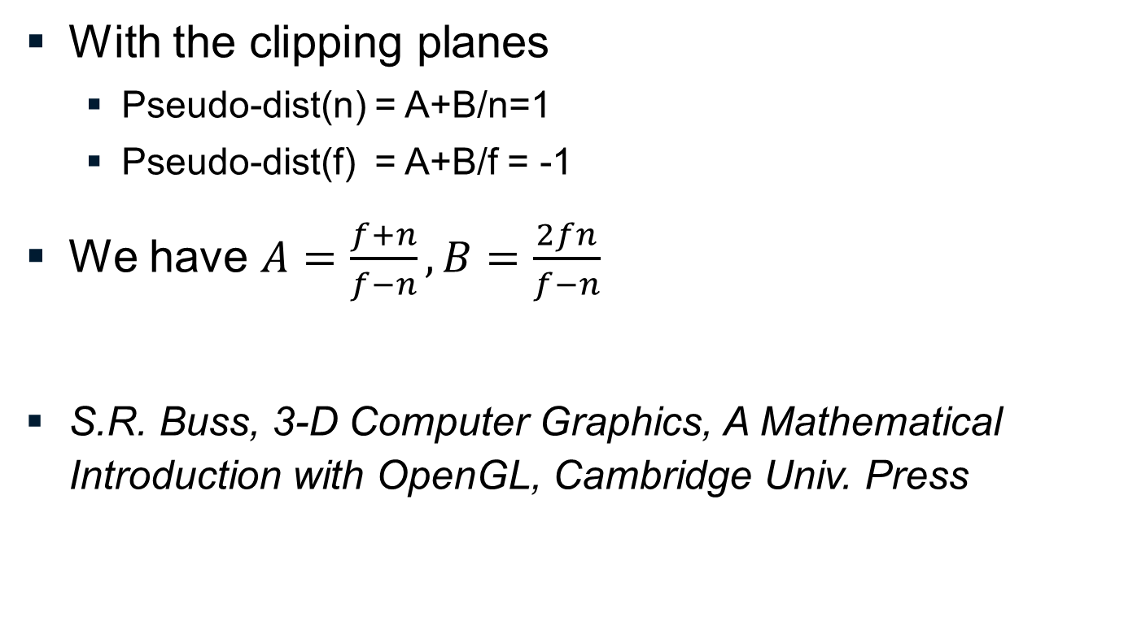
Perspective Projection

Slide 36
Perspective Projection
y
z
x

Slide 37
Perspective Projection
Note: additionally we want to map to the canonical view volume →
Note - slight difference to OpenGL:
n,f as distance vs n,f as coordinate position

Slide 38
Properties of Perspective
Maps
lines to lines
planes to planes
triangles to triangles

Slide 39
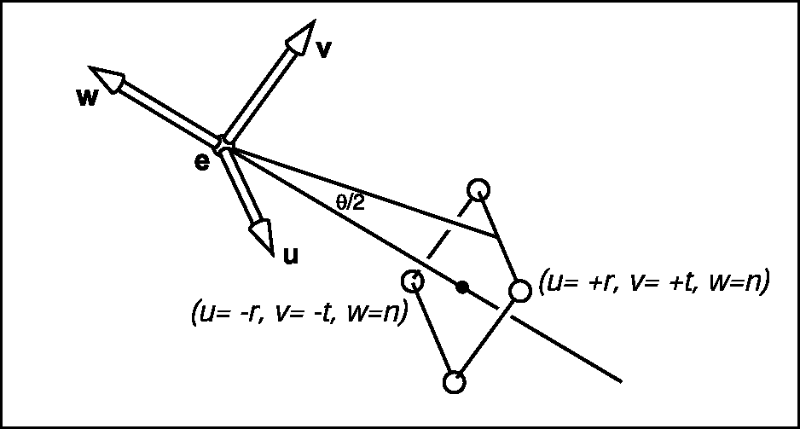
Field of View
Instead of any window (l,r,b,t) we use
a window centered at the origin
the aspect ratio between width and height

Slide 40
OpenGL Example
void gluPerspective ( GLdouble fovy , GLdouble aspect , GLdouble zNear , GLdouble zFar );

Slide 41
OpenGL Example
void glFrustum( GLdouble left, GLdouble right, GLdouble bottom, GLdouble top, GLdouble zNear, GLdouble zFar )

Slide 42
Perspective Projection Properties
special cases: z_{vp}=0 or z_{prp}=0
parallel lines parallel to view plane ⇒ parallel lines
parallel lines not parallel to view plane ⇒ converging lines (vanishing point)
lines parallel to coordinate axis ⇒ principal vanishing point (one, two or three)

Slide 43
Mesh Data Structures

Slide 44
Literature
Shirley et al. “Data Structures for Graphics”
mainly 12.1 / 12.2

Slide 45
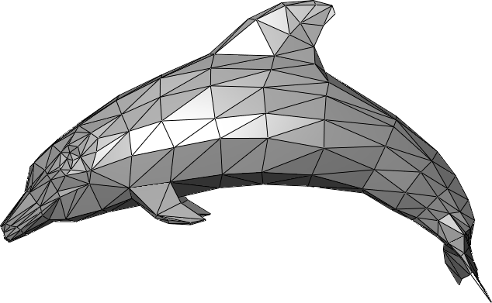
Triangle Mesh
Each triangle has three vertices in 3D Euclidian space

Slide 46
Triangle Mesh
Triangle soup: each triangle is stored by itself
Triangle Mesh: a data structure that allows access to neighborhood information

Slide 47
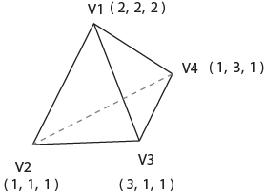

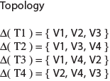
Mesh Properties
Geometry
Vertex positions
Topology
Neighbor information

Slide 48
Triangle Mesh Example
n₁
n₅
n₀
v₁
v₀
n₂
v₅
Face | Indices
f₀ | 0, 4, 3
f₁ | 0, 3, 1
f₂ | 1, 3, 2
f₃ | 0, 5, 6
f₄ | 0, 6, 4
f₅ | 4, 6, 7
v₂
n₆
n₄
n₃
v₆
v₄
v₇
v₃
n₇
Vertex | Coordinates
V₀ | x = … y = … z = …
V₁ | x = … y = … z = …
… | …
V₇ | x = … y = … z = …
Normal | Coordinates
n₀ | x = … y = … z = …
n₁ | x = … y = … z = …
… | …
n₇ | x = … y = … z = …
Texture | Coordinates
t₀ | u= … v= …
t₁ | u= … v= …
… | …
t₇ | u= … v= …

